Slide 1
Tree
CSC-114 Data Structure and Algorithms

Slide 2
Outline
Binary Tree Variations
Expression Tree
Construction
Evaluation

Slide 3
Why Binary Tree?
Every Data structure has its own efficiency and limitations
Arrays: Good for element access
Linked Lists: Good for insertions and deletions
Stacks and Queues: Where order is much important like mathematical expression evaluation, process scheduling on CPU
Tree: good where data has hierarchical relationship, like file system, parsers, decision making
One common issue with all above data structures is in-efficient information retrieval, takes O(n) time
Binary Trees can improve this time to an average case of O(log n)
Even though worst case can still leads to O(n) time but this can be improved using certain types of Trees. There are some variations of Binary Tree which guarantees O(log n) time for insertion, deletion and searching such as Binary Search Tree (BST), AVL Trees, Heaps etc.

Slide 4
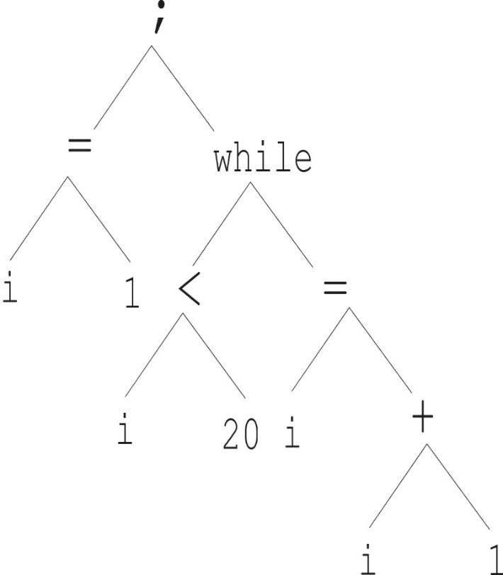
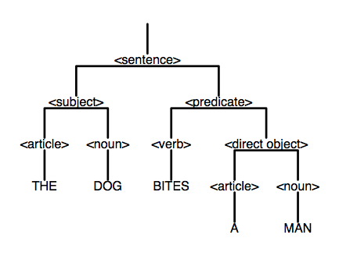
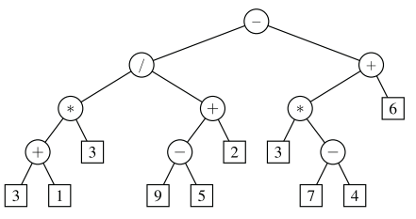
Parse Tree
Parse Trees are ordered trees which represents syntactic structure of programs according to context free grammar.
Used by language interpreters and compilers to evaluate programs. Tree helps to view program structure more clearly, and make it easy to decide which statements needs to be executed first

Slide 5
Expression Tree
A simple parse tree used by compiler to evaluate mathematical expression. It contains two types of nodes:
Operands→ leaf nodes
Operators → internal nodes
Expression trees are very useful to evaluate expressions.
No parentheses
No worry about order of precedence
Sub-tree will be evaluated before its parent node
Level of nodes presents relative order of operations
Higher the level, more is the precedence
Evaluate recursively
Very easy to get infix, postfix and prefix notations
Use DFS traversal orders
b*c
*
a
b
*
(a+b)*c
+
c
a
b
-
-a
a

Slide 6
How to Build Expression Tree
It depends which notation you have.
Which one is easy to build tree?
Prefix: + a * - * b c * / d ^ e f g h
Postfix: a b c * d e f ^ / g * - h * +
Infix: a + (((b * c) – (d / e ^ f) * g) * h)
Infix notation is evaluated according to precedence
Prefix is evaluated from right-to-left
Postfix is evaluated from left-right
+
a
*
-
h
*
*
d
c
/
g
d
^
e
f

Slide 7
Building Expression Tree with Infix Expression
Use two stacks, one for operators, other for tree nodes
Read the expression character by character from left to right
If character is operand
create its node and push to tree stack
Else If the character is operator
If operator is ‘(’
create its node and push to operator stack
Else If operator is ‘)’
While (top of operator stack is not equal to ‘(’ )
buildSubTree()
Pop operator stack // ( will be removed from stack
Else // +, -, *, / etc
While (operator stack is not empty OR precedence of operator < precedence of top of operator stack
buildSubTree()
create its node and push to operator stack
End If
While (operator stack is not empty) // Expression finished
buildSubTree()
Pop the tree stack for root node of tree and return //output
buildSubTree()
Pop the operator stack for operator node
pop tree stack, make popped node right child of operator node
Pop tree stack, make popped node left child of operator node
Push operator node to tree stack

Slide 8
Building Expression Tree with Infix Expression
a + (((b * c) – (d / e ^ f) * g) * h) a + (((b * c) – (d / e ^ f) * g) * h)
a
b
c
a
*
Tree stack
b
c
Operator stack
+ | ( | ( | ( | *
+ | ( | (

Slide 9
Building Expression Tree with Infix Expression
a + (((b * c) – (d / e ^ f) * g) * h) a + (((b * c) – (d / e ^ f) * g) * h)
a
*
d
e
f
a
*
^
b
c
b
c
e
f
+ | ( | ( | - | ( | / | ^
+ | ( | ( | - | ( | /

Slide 10
Building Expression Tree with Infix Expression
a + (((b * c) – (d / e ^ f) * g) * h) a + (((b * c) – (d / e ^ f) * g) * h)
a
*
/
a
*
/
b
c
d
^
b
c
d
^
e
f
e
f
+ | ( | ( | -
+ | ( | ( | - | *

Slide 11
Building Expression Tree with Infix Expression
a + (((b * c) – (d / e ^ f) * g) * h) a + (((b * c) – (d / e ^ f) * g) * h)
a
*
/
g
a
-
b
c
d
^
*
*
e
f
b
c
/
g
d
^
e
f
+ | ( | ( | - | *
+ | (

Slide 12
Building Expression Tree with Infix Expression
a + (((b * c) – (d / e ^ f) * g) * h) a + (((b * c) – (d / e ^ f) * g) * h)
+
a
-
h
a
*
*
*
-
h
d
c
/
g
*
*
d
^
d
c
/
g
e
f
d
^
+ | 9 | *
e
f

Slide 13
Building Expression Tree with Postfix Expression
Given postfix expression, its very easy to build an expression tree?
a b c * d e f ^ / g * - h * +
Read the expression character by character from left to right
If character is operand
create a node and push to a stack
If the character is operator
Create a node for this operator
pop stack, make it right child of this character node
Pop stack, make it left child of this character node
Push this node to stack
Do this process for remaining expression
a
b
c
a
*
b
c

Slide 14
Building Expression Tree with Postfix Expression
a b c * d e f ^ / g * - h * + a b c * d e f ^ / g * - h * + a b c * d e f ^ / g * - h * +
a b c * d e f ^ / g * - h * + a b c * d e f ^ / g * - h * +
a
b
c
a
*
d
e
f
a
*
/
b
c
b
c
d
^
e
f
a
*
a
*
d
^
b
c
b
c
e
f

Slide 15
Building Expression Tree with Postfix Expression
a b c * d e f ^ / g * - h * + a b c * d e f ^ / g * - h * + a b c * d e f ^ / g * - h * +
a
*
/
g
a
*
*
a
-
b
c
d
^
b
c
/
g
*
*
e
f
d
^
b
c
/
g
e
f
d
^
e
f

Slide 16
Building Expression Tree with Postfix Expression
a b c * d e f ^ / g * - h * + a b c * d e f ^ / g * - h * + a b c * d e f ^ / g * - h * +
+
a
a
*
a
*
-
h
-
h
*
*
*
*
d
c
/
g
d
c
/
g
d
^
d
^
e
f
e
f

Slide 17
Traversal
DFS traversal order provides us respective notations
Pre-order: + a * - * b c * / d ^ e f g h
Post-order: a b c * d e f ^ / g * - h * +
In-order: a + (((b * c) – (d / e ^ f) * g) * h)
In-order traversal needs modification
We need to insert parenthesis
+
a
*
-
h
*
*
d
c
/
g
d
^
e
f

Slide 18
In-order Traversal
What is in-order traversal of following trees?
What is the problem?
We need to put parenthesis
*
+
a
+
*
c
b
c
a
b

Slide 19
InOrder Traversal
Algorithm: IINFIX(Tree node)
Input: a root node of an expression tree
Output: infix expression
Start
If node is not NULL
If node is operator
Print “(”
End if
INFIX (node.left)
Print (node)
INFIX (node.right)
If node is operator
Print “)”
End if
End if
End
What change is required? If we want to return the expression, rather than just printing
*
+
a
+
*
c
b
c
a
b
(a*(b+c))
((a*b)+c)

Slide 20
Evaluation
How to evaluate expression tree?
Possible ways:
Recursively evaluate nodes
Evaluate(node)
If node is not null
If node is number //node is operand
return node.data // it’s a leaf node, no further calls
Else // node is operator
n1=Evaluate(node.left) //evaluate left part
n2=Evaluate(node.right) // evaluate right part
opr= node.data // operator
return doOperation(n1, n2, opr) // apply operator and return result
Else
Return 0
End If
Get a prefix or postfix traversal order and evaluate using stack
Refer to previous lectures
+
a
*
-
h
*
*
d
c
/
g
d
^
e
f

